Slide 1

Professional Ethics of Software Engineers: An Ethical Framework
Published: 29 May 2015
Presented By:
Moiz Ali – M46
Presented to:
Miss Ayesha Irfan

Slide 2
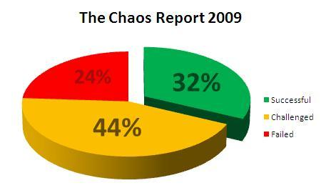
Introduction
Some past faulty engineering cases like in 1981 (Ford Pinto Gasoline tank), in 1989 (Space Shuttle Challenger disaster) or in 1997 (Collapse of the pedestrian bridge) have given rise to various discussions about engineering ethics.
The software crisis is reflected in irregular schedules, budget overruns, software that is inefficient or of low quality, non-compliance, and programs that are not delivered. 75% software failures are in the sense that they do not meet customer requirements. 15% software failures at the start of the development, almost half of the projects run into problems.
In 2009 Standish Group report says; 32% Projects success rate increases which are delivered on time, on budget, with required features and functions. 44% are late delivered, over budget and with less required features and functions. 24% are failed which are prior to completion or delivered and never used.
Software crisis are caused by company’s ability and organization, which involves poor planning, unclear goals and objectives, sudden changes in the mid of project progress and unrealistic time and cost estimates.
Over time the software crisis has been dealt with the development of dedicated software tools, different frameworks, tools, programming paradigms and programming languages, improved modeling and design, well maintained software architectures and improved testing methodologies, principles and maintenance.

Slide 3
Literature Review
Ref # | Year | Author | Method | Conclusion
[1] | 1996 | Michael Davis | what effect different definitions may have on our understanding of engineering | Few “software engineers” satisfy either of these conditions. It is an open question whether they should be.
[2] | 1996 | Ford, Gary; Gibbs, Norman E. | A mature profession of Software Engineering | Several professions are examined to provide best examples and prediction of evolution of a Mature Profession.
[3] | 1981 | Richard T. De George | Ethical responsibilities of Engineers in large Organizations | Ethical responsibilities and behavior with professional skills leads to success.
[4] | 2002 | Brian J. Farrell Deirdre M. Cobbin Helen M. Farrell | Evolution, development and controversies about ethics. | Prescriptive documents are the only satisfactory content and best practice for code of ethics.
[5] | 2011 | Josep M. Basart Montse Serra | Engineering ethics beyond Engineer’s Ethics | Ethics, Rights and CSR are very important in order to get successful projects.

Slide 4
Engineering Vs Software Engineering
Engineering Field
Software Engineering
The American Engineers Council for Professional Development (ECPD) defines the engineering field as a ‘‘creative application of scientific principles…all as respects an intended function, economics of operation and safety to life and property’’.
According to Oxford English Dictionary engineering is defined as; “The branch of science and technology concerned with the design, building and use of engines, machines, and structures”.
In 1968, NATO defined software engineering as; “the establishment and use of sound engineering principles in order to obtain economical software that is reliable and works efficiently on real machines.”
In 1990, the IEEE (professional association of engineers) defined software engineering as; “The application of a systematic, disciplined, quantifiable approach to the development, operation, and maintenance of software; that is, the application of engineering to software.”

Slide 5
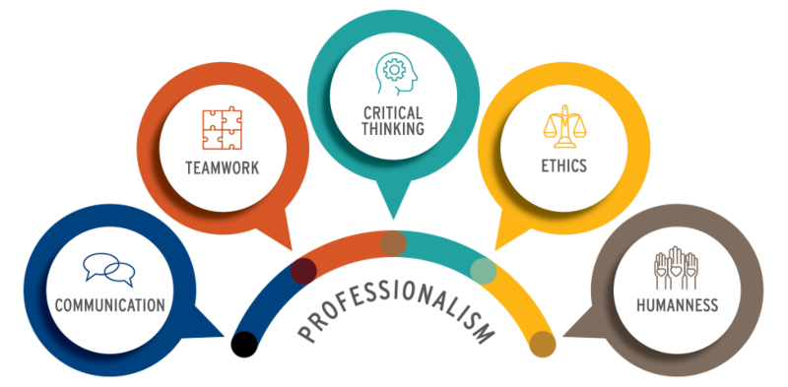
Professionalism: Engineering & Software Engineering
Profession
In 1915 speech, Abraham Flexner proclaimed; “Professions involve essentially intellectual operations with large individual responsibility; they derive their raw material from science and learning; this material they work up to a practical and definite end; they possess an educationally communicable technique; they tend to self-organization; they are becoming increasingly altruistic in motivation.”
Ernest Greenwood in 1957 cited five attributes of a profession; Communication, teamwork, critical thinking, ethical code and community

Slide 6
Professionalism: Engineering & Software Engineering
Michael Davis Criteria (1996)
Software Engineering
Michael Davis (1996) took a very critical position of software engineers. And second, is it, ethically speaking, a professional occupation? From the normative perspective, he argued that the activities of software engineers constitute neither an engineering occupation nor, ethically speaking, a professional occupation: The history of a profession is the history of how a certain occupation organized itself to hold its members to certain standards, beyond what law, market and morality demand.
Professionals have a special responsibility to adhere to a certain spirit, a calling which is beyond just following the rules (Davis 1996). This ‘‘commitment to use the knowledge according to certain codes…and adhere to a certain spirit’’
Software engineering is an occupation that builds practical skills based on the theoretical foundations of computer science together with practical expertise in the engineering methodologies aimed at the development of software systems.
The difference between software engineers and computer scientists is that while computer scientists suggest computational methods and solutions, software engineers design and implement the processes and methods that will engender quality and economic benefit.
As a profession, it must abide by certain standards in terms of quality, processes, methods, and tools, among other issues that include scheduling, economics, risk and coding. The codes eight principles pertain to the engineer’s relationship with the following stakeholders: Public, Client and Employer, Product, Judgement, Management, Profession, Colleagues and Self.

Slide 7
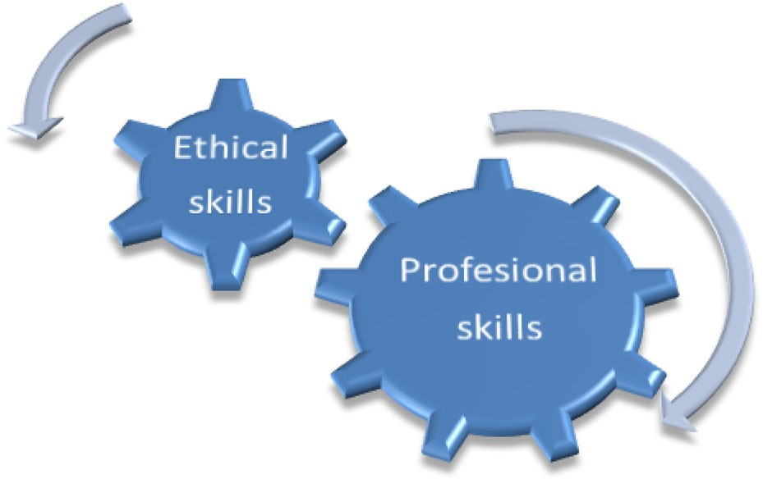
The Synergy Between Ethical and Professional Skills
Software Packages are like a “Black Box” which includes infrastructure, features and functions.
End users have no idea how to interact with it but software engineers should provide an essential service to end users. Because the service they provide is more important then the tangible good delivered. There should be no separation between professional practice and ethical skills. In other words, the ethical and professional skills associated with software engineering should synergies.
The design methodologies of software engineers explicitly take ethical values into account in the design process of a software product in the form of soft constraints that are identified in the requirements phase of the engineers` software development.
The professional activities of engineers in general and software engineers in particular are defined in the life cycle of a software product and include the requirements, specifications, analysis, design, development, evaluation and maintenance of the software package.
The main goal is to create an “Ethical Framework” which will effect the life cycle of software development process and inherently connected to the day-to-day activities of software engineers. This concept “Ethical framework” will be a skeleton abstraction of a solution in the field of software development process for users and their projects and team.

Slide 8
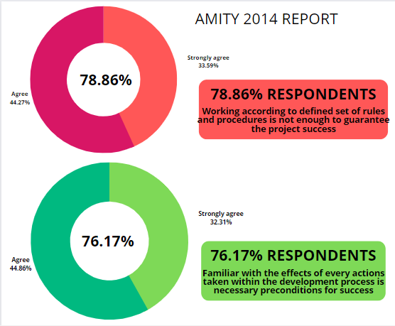
Ethical-Driven Software Development(EDSD) An Ethical Framework
Ethical Framework, in the world of development, is a sub-system design made up of a collection of abstract and concrete classes and the interface between them.. Framework are generic and extended to create a more specific application or subsystem.
Ethical framework should provide ethical checklist that will be integral to software’s development life cycle. It will provide awareness and commitment of the software engineer to think about stakeholders and risk involved.
EDSD is a software engineering framework that is independent of development methodology, development team and specific project. Its goal is to obtain quality engineering perspective by adopting ethical objects for all development cycles.

Slide 9
EDSD Index Card’s Yes/No Questionnaire
Initiation Phase | Supplier’s product is according to criteria ? Does the product demanding or not ? Does the criteria is fulfilling the initializing steps ? Is it finalized the who is responsible for budgetary, decision making and other abnormalities in the scope of project.
Requirements Phase | Has it been determined who defined the requirements? Is it cleared that if a steps is not achieved then what would be the alternatives? Is that clear, the client’s requirements are legal or not? Prior requirements are cleared or not?
Design Phase | Do all the design patterns approach are cleared? Would it be easy to implement the diagrams? Diagrams are cleared? Easy for a person who is not expert? All the diagrams are sufficient? Fulfilling all the requirements?
Development Phase | Coding languages are defined? Conditions are set to the languages? Does languages are integrating young and less experience developers? Is it easy to orientate the code you want? Code is compatible with the design pattern?
Testing & verification Phase | All the errors are fixed before sending it to client? Distinguish between a quality product vs a correct product? All the required tests are performed? Is their any need of mandatory test?

Slide 10
Conclusion
The Purpose of this article is to propose an ethical framework for software engineers that connects software developers’ ethical responsibilities directly to their professional standards.
The implementation of such an ethical framework can overcome the traditional dichotomy between professional skills and ethical skills, EDSD is a novel and practical approach to software development that bridges the gap and creates a link between ethical and professional skills, thus proposing a process of software development that is more transparent and brings to better awareness of the risks and limitations in the process of software development.

Slide 11

THANK YOU!
MOIZ ALI
Class
7th B Morning
Department
Information Technology

